Slide 1
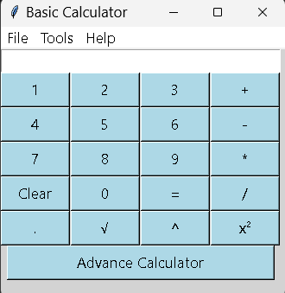
Project 1- Basic Calculator
-using python

Slide 2
Introduction
In this project, we will build a simple graphical user interface (GUI) calculator using Python's Tkinter library. The calculator will perform basic arithmetic operations such as addition, subtraction, multiplication, and division. Additionally, it will include advanced functions like square roots and exponentiation.
This presentation will guide you through the process of building a simple calculator using Python, a practical project that demonstrates core programming concepts and the power of the Python language.

Slide 3
Tools and Technologies
Python: The primary programming language for the project.
Tkinter: A standard Python library for creating graphical user interfaces.
VS Code: A popular code editor for writing and testing Python scripts.
Math Library: Utilized for advanced mathematical operations.

Slide 4
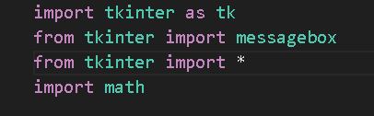
Importing libraries in python
We first starts with importing different libraries which will help us in our project.
Tkinter - For creating GUI
Math - To perform various mathematical operation

Slide 5
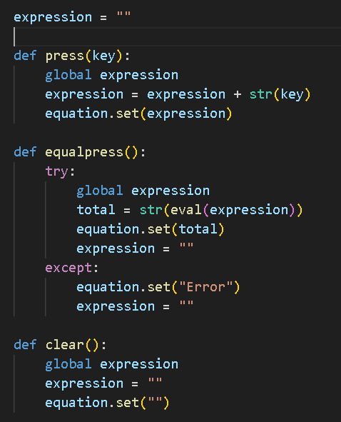
Defining functions and global variable
Here we define a global expression which will store all the inputs of the calculator
Defining various function, which will be used for giving commands.
Like press , equal press ,clear etc

Slide 6
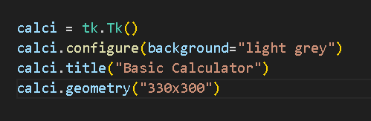
Building a GUI
Here we are creating a base for our application by defining its various parameters such as
-Title
-Geometry
-Colour

Slide 7
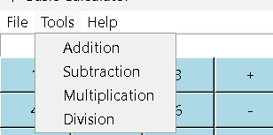
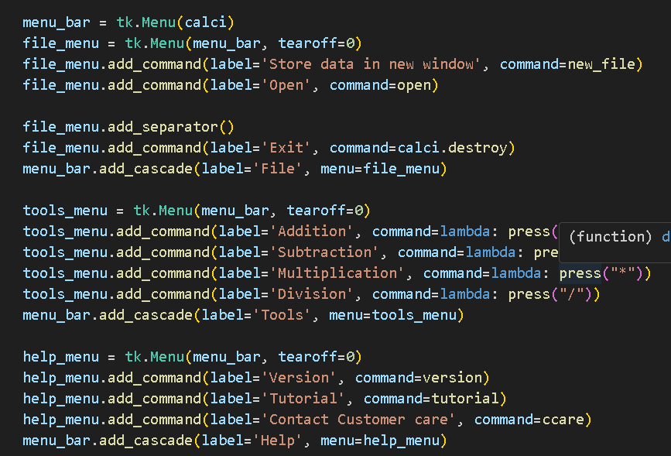
Creating menu bars
Here we create a menu bar by using tk.Menu() and define other sub menus with different functions.
File menu
Tool menu
Help menu

Slide 8

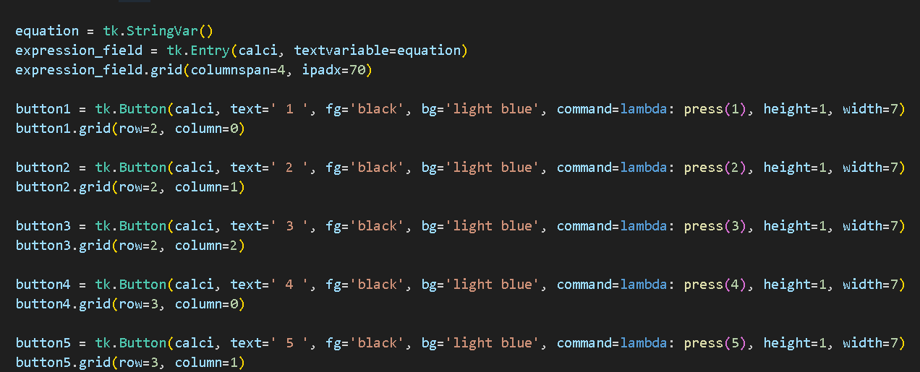
Defining Entry widget and buttons
Entry widget for displaying the input of the user and for showing final result of the expression.
Buttons are inputs that user will give to the application.

Slide 9

mainloop()
Starts the Tkinter event loop.
It keeps the application running, handles events, and updates the GUI.

Slide 10
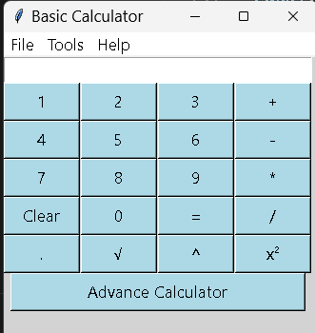
Testing and Debugging
Thoroughly test the calculator application to ensure all functionalities work as expected. Perform extensive testing and debug any issues that arise to guarantee a reliable and accurate calculator experience.

Slide 11
Conclusion
In conclusion, creating a basic calculator application with Python and Tkinter provides a hands-on opportunity to understand GUI development and application logic. This project serves as a foundation for exploring more advanced applications and software development.

Slide 12
Thank you
Pradeep Kumar Chauhan
DS and AI Batch

